Slide 1

INSTITUTE : UIE
DEPARTMENT : CSE
Bachelor of Engineering (Computer Science & Engineering)
PROJECT BASED LEARNING IN JAVA
(20CST-319/20ITT-319)
TOPIC OF PRESENTATION:
Byte stream, Character stream, Object serialization, cloning.
DISCOVER . LEARN . EMPOWER

Slide 2

Lecture Objectives
In this lecture, we will discuss:
Byte stream, Character stream, Object serialization, cloning.

Slide 3
Stream Classes
A stream is an abstraction that either produces or consumes information. A stream is linked to a physical device by the Java I/O system.
An input stream can abstract many different kinds of input: from a disk file, a keyboard, or a network socket. Likewise, an output stream may refer to the console, a disk file, or a network connection.
Java implements streams within class hierarchies defined in the java.io package.

Slide 4
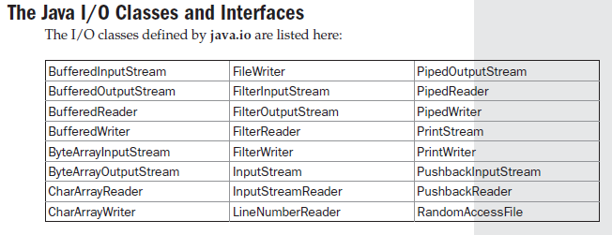

Slide 5
Java’s stream-based I/O is built upon four abstract classes: InputStream, OutputStream, Reader, and Writer.
InputStream and OutputStream are designed for byte streams.
Reader and Writer are designed for character streams.

Slide 6
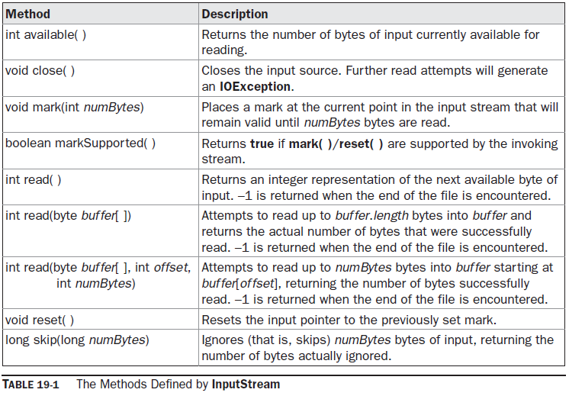
The Byte Streams
InputStream is an abstract class that defines Java’s model of streaming byte input.

Slide 7
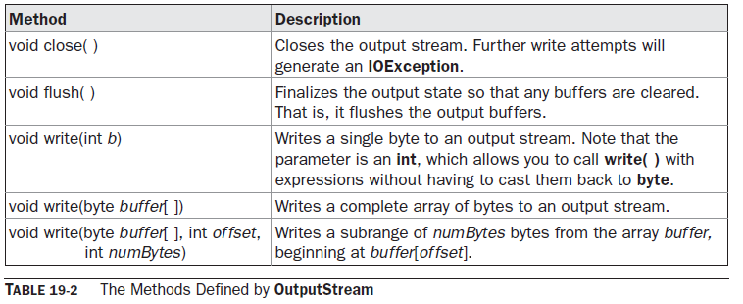
OutputStream is an abstract class that defines streaming byte output.

Slide 8
FileInputStream The FileInputStream class creates an InputStream that you can use to read bytes from a file. FileInputStream(String filepath) FileInputStream(File fileObj) throw a FileNotFoundException Eg:: FileInputStream f0 = new FileInputStream("/autoexec.bat") File f = new File("/autoexec.bat"); FileInputStream f1 = new FileInputStream(f); FileInputStream overrides six of the methods in the abstract class InputStream. The mark( ) and reset( ) methods are not overridden, and any attempt to use reset( ) on a FileInputStream will generate an IOException.

Slide 9
FileOutputStream FileOutputStream creates an OutputStream that you can use to write bytes to a file. FileOutputStream(String filePath) FileOutputStream(File fileObj) FileOutputStream(String filePath, boolean append) FileOutputStream(File fileObj, boolean append) filePath is the full path name of a file, and fileObj is a File object that describes the file. If append is true, the file is opened in append mode.

Slide 10
ByteArrayInputStream ByteArrayInputStream is an implementation of an input stream that uses a byte array as the source. ByteArrayInputStream(byte array[ ]) ByteArrayInputStream(byte array[ ], int start, int numBytes) ByteArrayOutputStream ByteArrayOutputStream is an implementation of an output stream that uses a byte array as the destination. ByteArrayOutputStream( ) // a buffer of 32 bytes is created ByteArrayOutputStream(int numBytes)

Slide 11
Buffered Byte Streams For the byte-oriented streams, a buffered stream extends a filtered stream class by attaching a memory buffer to the I/O streams. This buffer allows Java to do I/O operations on more than a byte at a time, hence increasing performance. Because the buffer is available, skipping, marking, and resetting of the stream become possible. The buffered byte stream classes are BufferedInputStream and BufferedOutputStream.

Slide 12
BufferedInputStream Java’s BufferedInputStream class allows you to “wrap” any InputStream into a buffered stream and achieve this performance improvement. BufferedInputStream has two constructors: BufferedInputStream(InputStream inputStream) BufferedInputStream(InputStream inputStream, int bufSize)

Slide 13
BufferedOutputStream A BufferedOutputStream is similar to any OutputStream with the exception of an added flush( ) method that is used to ensure that data buffers are physically written to the actual output device. BufferedOutputStream has two constructors: BufferedOutputStream(OutputStream outputStream) BufferedOutputStream(OutputStream outputStream, int bufSize)

Slide 14
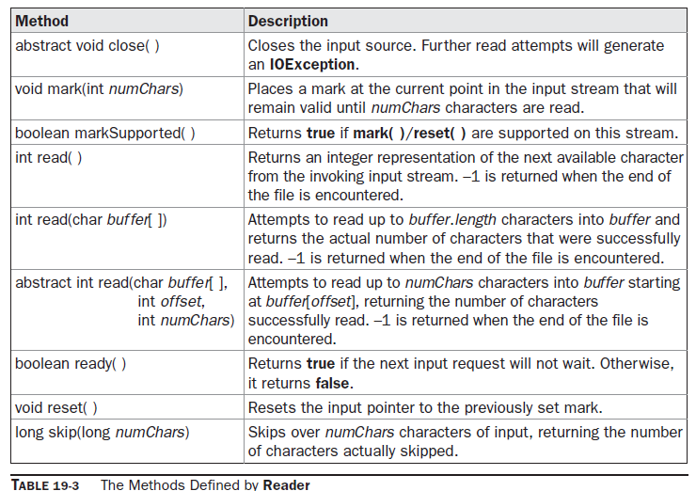
The Character Streams Reader Reader is an abstract class that defines Java’s model of streaming character input. It implements the Closeable and Readable interfaces.

Slide 15
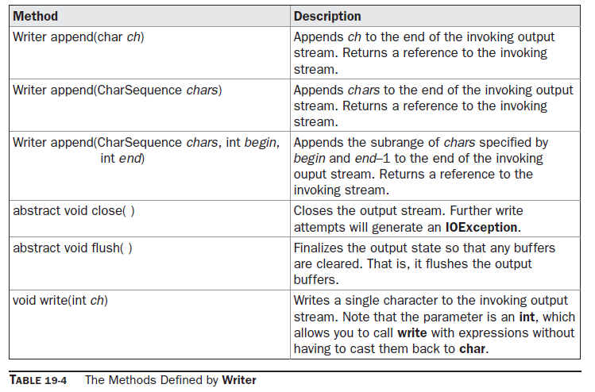
Writer Writer is an abstract class that defines streaming character output. It implements the Closeable, Flushable, and Appendable interfaces.

Slide 16
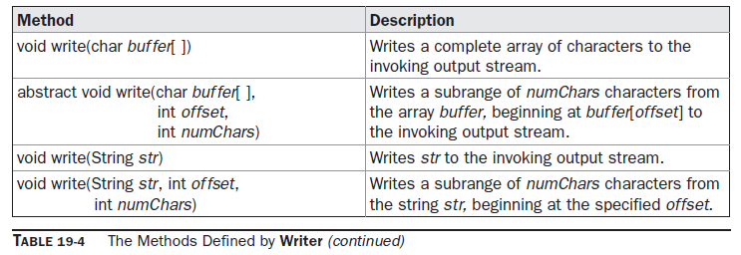

Slide 17
FileReader The FileReader class creates a Reader that you can use to read the contents of a file. FileReader(String filePath) FileReader(File fileObj) throw a FileNotFoundException. FileWriter FileWriter creates a Writer that you can use to write to a file. FileWriter(String filePath) FileWriter(String filePath, boolean append) FileWriter(File fileObj) FileWriter(File fileObj, boolean append) throw an IOException.

Slide 18
CharArrayReader CharArrayReader is an implementation of an input stream that uses a character array as the source. CharArrayReader(char array[ ]) CharArrayReader(char array[ ], int start, int numChars) CharArrayWriter CharArrayWriter is an implementation of an output stream that uses an array as the destination. CharArrayWriter( ) CharArrayWriter(int numChars)

Slide 19
Object serialization is the process of saving an object's state to a sequence of bytes (on disk), as well as the process of rebuilding those bytes into a live object at some future time • The Java Serialization API provides a standard mechanism to handle object serialization • You can only serialize the objects of a class that implements Serializable interface. After a serialized object is written to a file, it can be read from t he file and deserialized (that is we can recreate the object in memory) • The process of Serialization and DeSerialization is JVM independent. That is, an object can be serialized on one platform and deserialized on an entirely different platform. • Classes ObjectInputStream and ObjectOutputStream are us ed for serialization & deserialization.
Serialization

Slide 20
• How to Write to an ObjectOutputStream FileOutputStream out = new FileOutputStream("theTime"); ObjectOutputStream s = new ObjectOutputStream(out); s.writeObject("Today"); s.writeObject(new Date()); s.flush(); • How to Read from an ObjectOutputStream FileInputStream in = new FileInputStream("theTime"); ObjectInputStream s = new ObjectInputStream(in); String today = (String)s.readObject(); Date date = (Date)s.readObject();
Serializing Objects

Slide 21
package m10.io; import java.io.*; public class MyClass implements Serializable { String s; int i; double d; public MyClass(String s, int i, double d) { this.s = s; this.i = i; this.d = d; } public String toString() { return “s=“ + s + “; i=“ + i + “; d=“ + d; } }
Object Serialization

Slide 22
public class SerializationDemo { public static void main(String args[]) { try { MyClass object1 = new MyClass(“Hello”, -7, 2.7e10); System.out.println(“object1; “ + object1); FileOutputStream fos = new FileOutputStream(“serial”); ObjectOutputStream oos = new ObjectOutputStream(fos); oos.writeObject(object1); oos.flush(); oos.close(); } catch(Exception e) { System.out.println(“Exception during serialization:“+ e); System.exit(0); }
Object Serialization

Slide 23
// Object Deserialization try { MyClass object2; FileInputStream fis = new FileInputStream(“serial”); ObjectInputStream ois = new ObjectInputSream(fis); object2 = (MyClass)ois.readObject(); ois.close(); System.out.println(“object2: “ + object2); } catch(Exception e) { System.out.println(“Exception during deserialization: “ + e); System.exit(0); } } }
Object Serialization

Slide 24
transient keyword is used in Object Serialization. By default, when you serialize an object, all its fields are serialized except for static variables. When you construct this object back from its persistent state, you will get the values of all the fields that are serialized(except static variables). If you do not want to store the value of a particular non-static field, then you can declare this field as transient. This keyword is used only with a variable declaration.
The keyword : transient

Slide 25
Transient keyword provides us with the ability to control the ser ialization process and gives us the flexibility to exclude some of object properties from serialization process. • Sometimes, it does make sense not to serialize certain attributes of an object. For e.g. If you are developing an application for Weather forecasting and you have created objects that store current weather conditions, the n storing current temperature does not make much sense, since temperature keeps fluctuating and you may not require the temp data at a later date when you de-serialize this object.
The keyword : transient

Slide 26
import java.io.*; class Xyz implements Serializable { double d1; transient double d2; static double d3; void m1() { System.out.println("The value of d1 is :" +d1); System.out.println("The value of d2 is :" +d2); System.out.println("The value of d3 is :" +d3); } }
The keyword : transient

Slide 27
class TransientExample1 { public static void main(String [] args) throws IOException { Xyz x = new Xyz(); x.d1=10.3; x.d2=20.5; x.d3=99.99; x.m1(); FileOutputStream fx = new FileOutputStream("A1.xyz"); ObjectOutputStream ox = new ObjectOutputStream(fx); ox.writeObject(x); ox.flush(); } }
The keyword : transient

Slide 28
import java.io.*; class TransientExample2 { public static void main(String [] args) { try { FileInputStream fx = new FileInputStream("A1.xyz"); ObjectInputStream ox = new ObjectInputStream(fx); Xyz x = (Xyz) ox.readObject(); x.m1(); } catch(Exception e) { System.out.println(e); } } }
The keyword : transient

Slide 29
Summary:
In this session, you were able to :
Learn about IO Stream, Serialization and deserialization.

Slide 30
References:
Books:
1. Balaguruswamy, Java.
2. A Primer, E.Balaguruswamy, Programming with Java, Tata McGraw Hill Companies
3. John P. Flynt Thomson, Java Programming.
Reference Links:
https://www.javatpoint.com/java-io
https://www.tutorialspoint.com/java/java_files_io.htm
https://docs.oracle.com/javase/tutorial/essential/io/streams.html
https://www.programiz.com/java-programming/io-streams
http://tutorials.jenkov.com/java-io/streams.html
Video Links:
https://youtu.be/3YRahx2ltSg
https://youtu.be/mq-f7zPZ7b8
https://youtu.be/6B6vp0jZnb0

Slide 31
THANK YOU

